Slide 1
The Great Vacation
-United States of America

Slide 2
The Hello Song Hello! How are you? Hello! How are you? I’m fine, fine, fine. I’m fine, fine, fine.
Notes:
TD: T teaches the Hello Song to S by singing line by line. After each line, T stops and lets S sing. Once the entire song is taught, T and S sing it completely two more times.

Slide 3
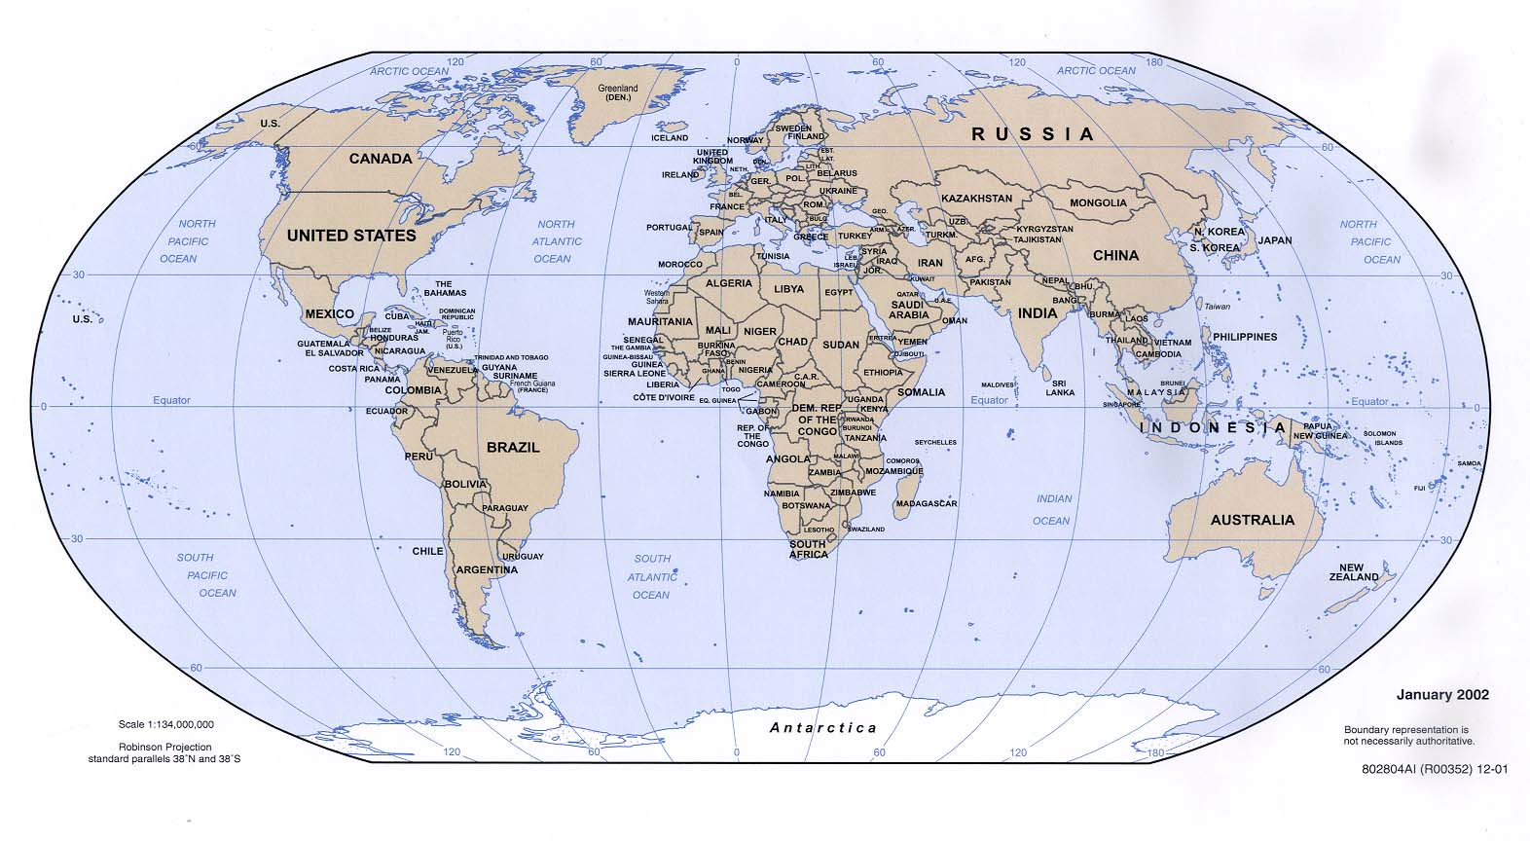
This is a map of the world. Where is China?
Notes:
TD: T asks S if they can find China. Check to see if the student is correct.

Slide 4
Can you find the United States?
Notes:
TD: T asks S if they can find the United States. Check to see if the student guessed correctly.

Slide 5
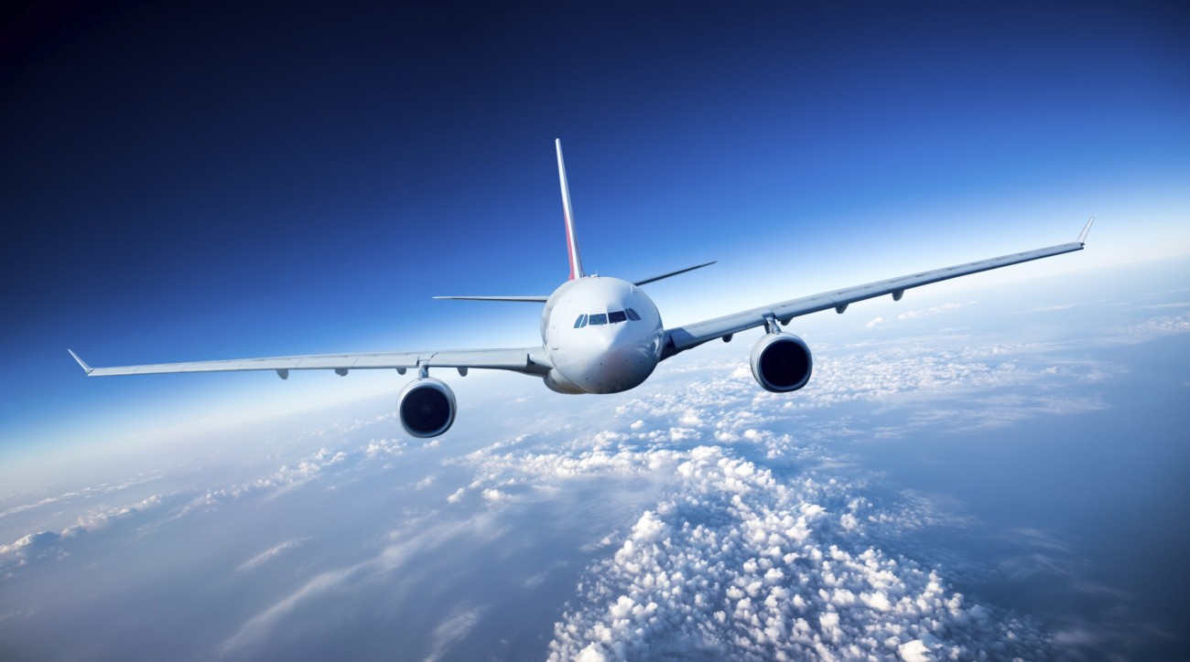
Let’s go!
Notes:
TD: T indicates we are going on a trip to the United States.

Slide 6
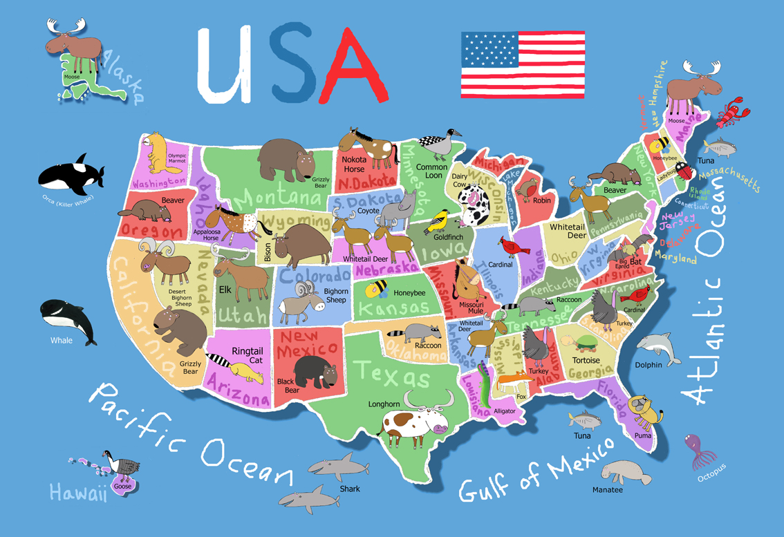
We made it!
Notes:
TD: T asks S what they can see on the map.

Slide 7
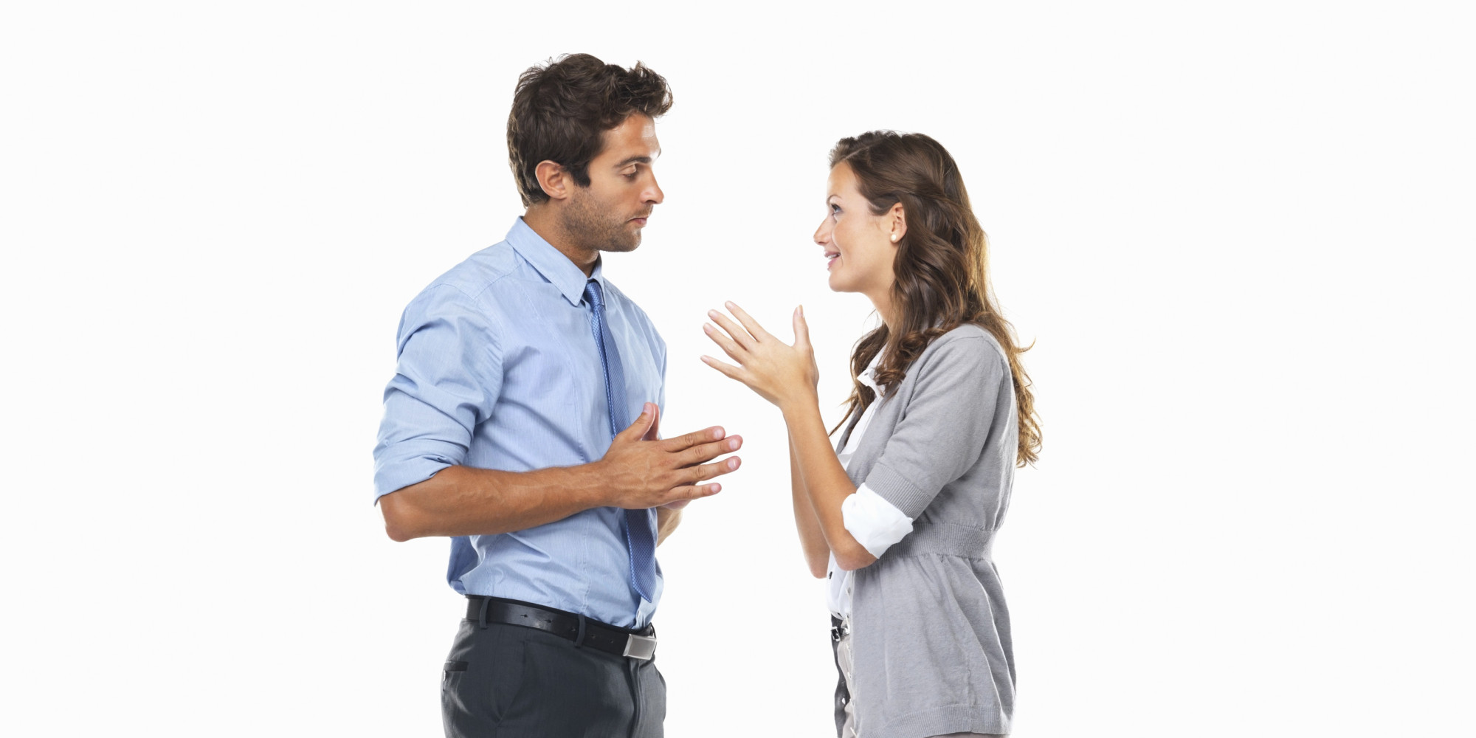
!
Hello!
Hola!
Americans speak English.
Many Americans also speak Spanish.
Notes:
TD: Highlight difference between English and Spanish. Ask S what other languages they can speak.

Slide 8
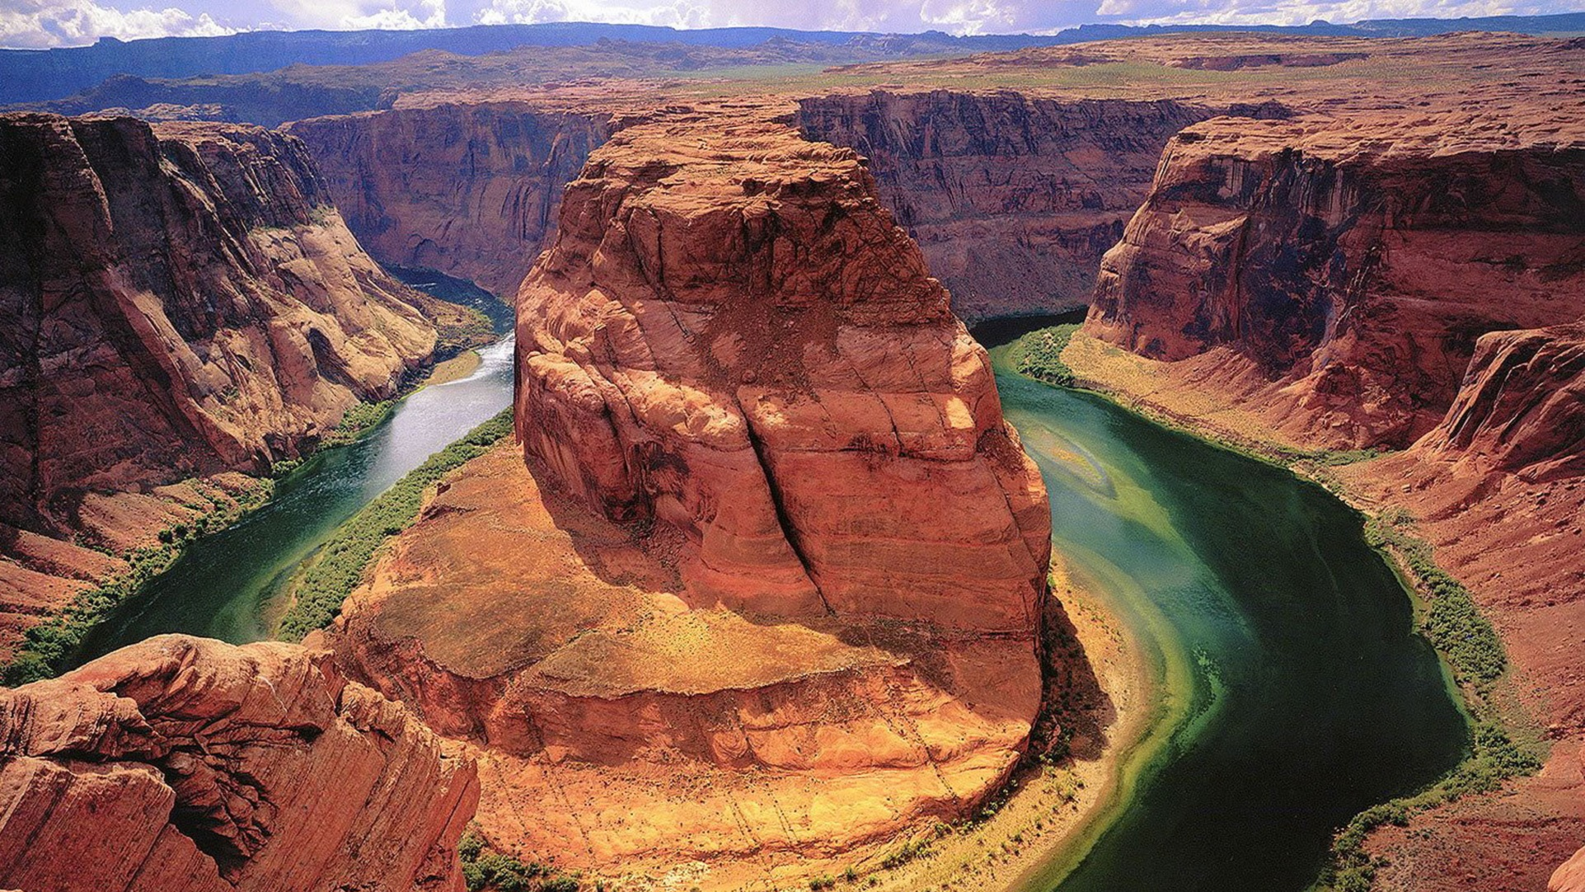
America has many interesting things to see. This is the Grand Canyon.
Notes:
TD: Ask S to describe what they can see in this picture.

Slide 9

America has many big cities.
This is New York City.
Notes:
TD: Ask S what they can see in this picture (i.e. tall buildings, lights, etc.). See if S can name another city.

Slide 10
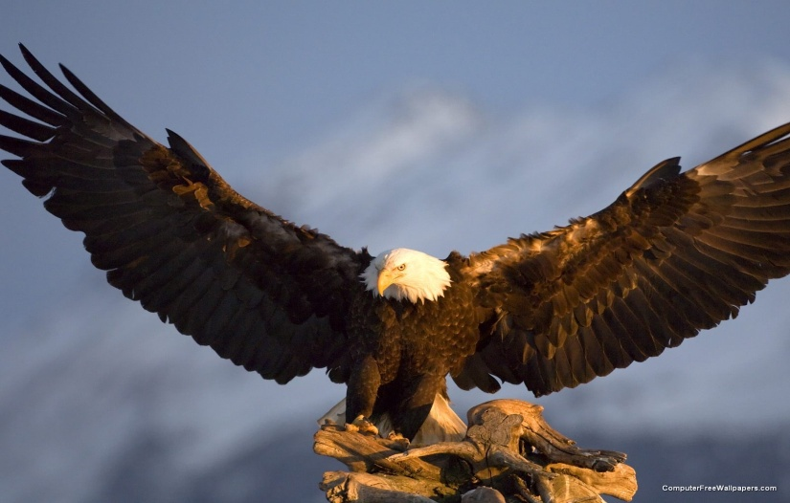
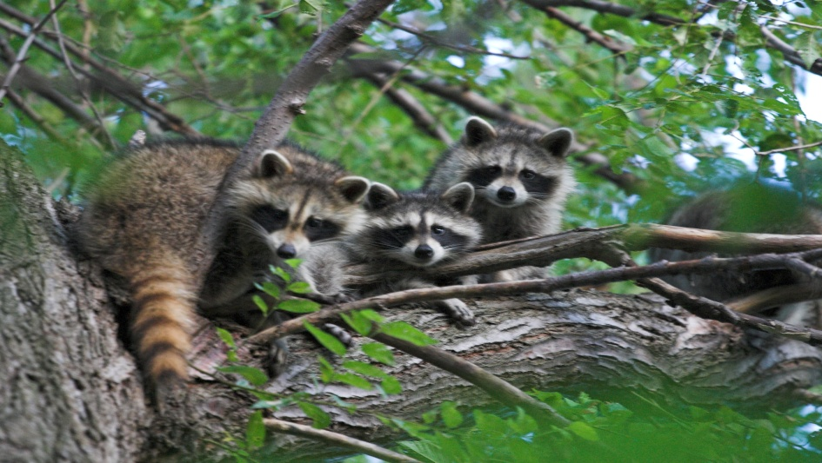
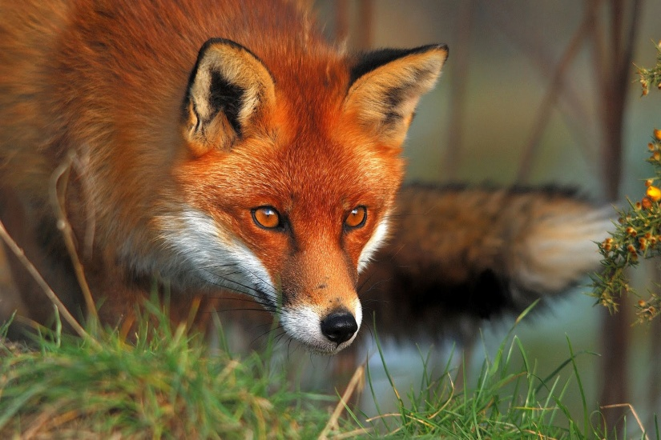
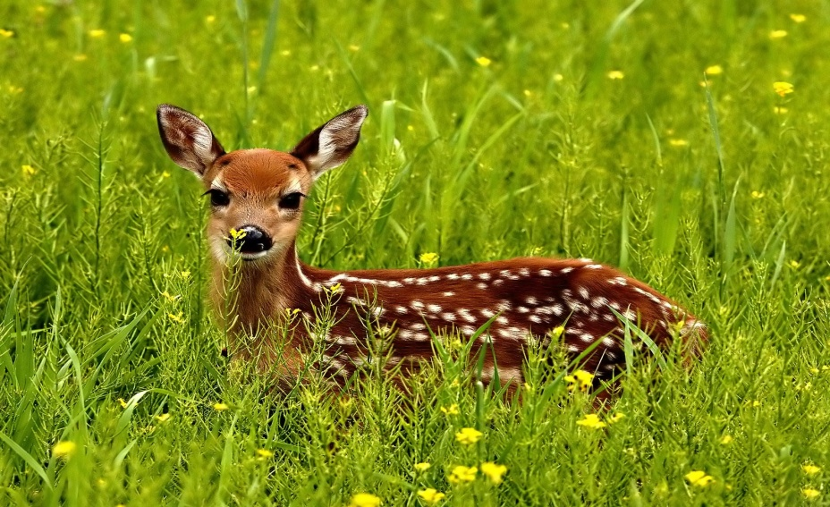
bald eagle
raccoon
fox
deer
The United States has many animals.
Notes:
TD: T firsts asks S if they can name the animals in the pictures. If not, review.

Slide 11
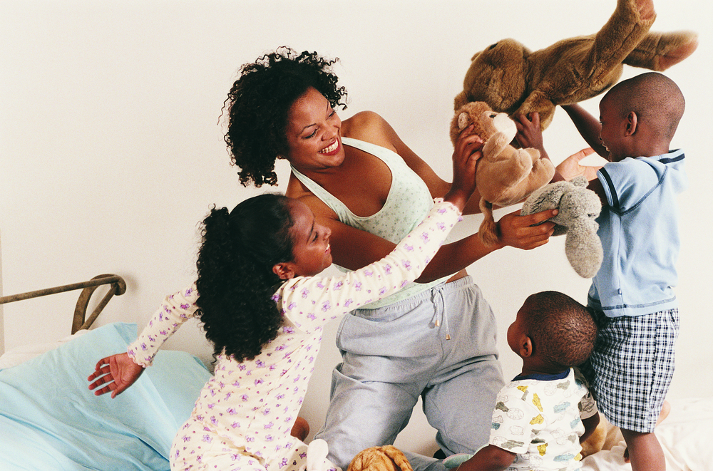
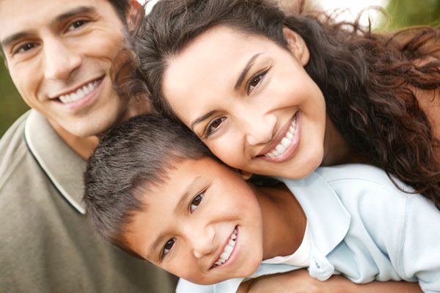
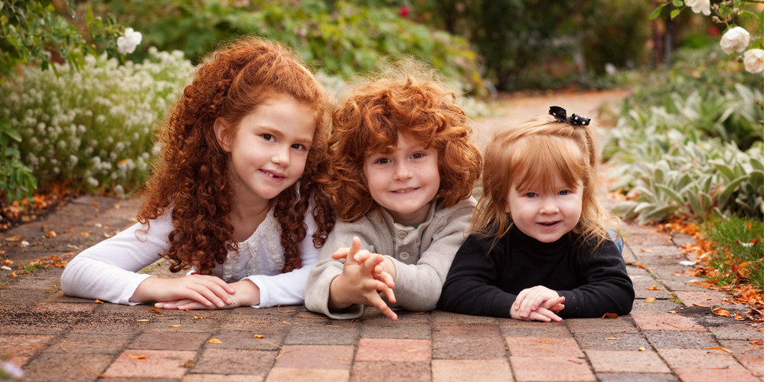
Many different people live in the USA.
Notes:
TD: Have students describe the different people they see in each picture.

Slide 12
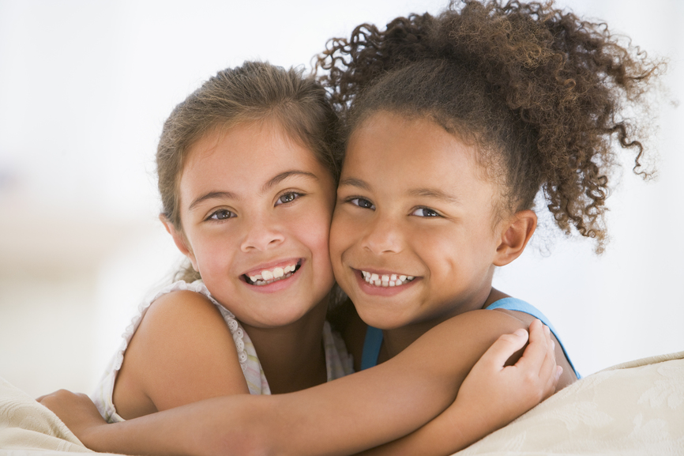
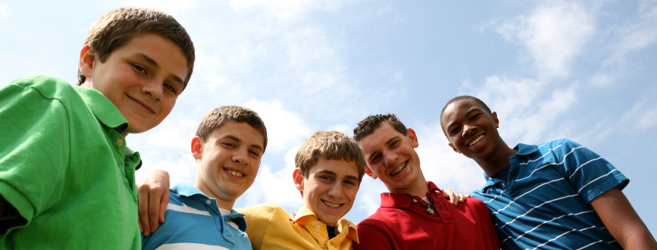
These girls are friends.
These boys are
friends.

Slide 13
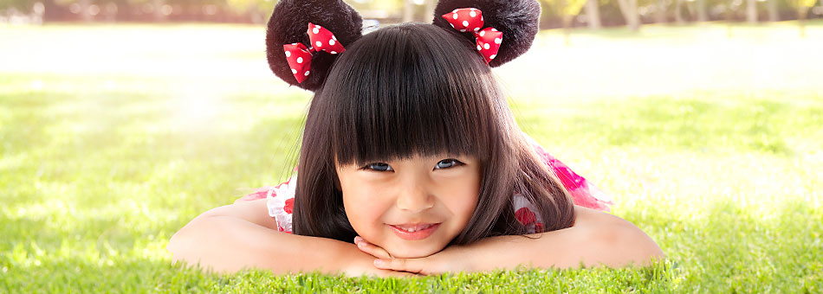
Jen wants to be your friend.

Slide 14
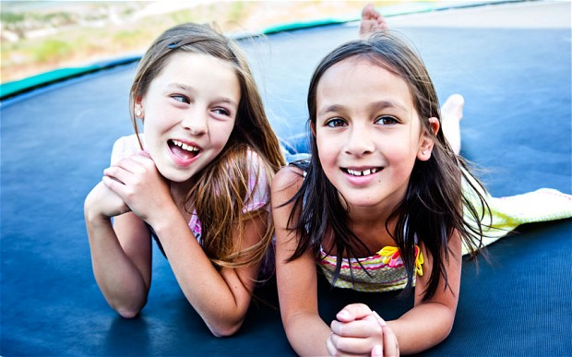
These girls are friends. What do they like to do?
Notes:
TD: Ask student to describe what they enjoy doing with their friends. What do these friends like to do? Do you like to do the same thing with your friends?

Slide 15
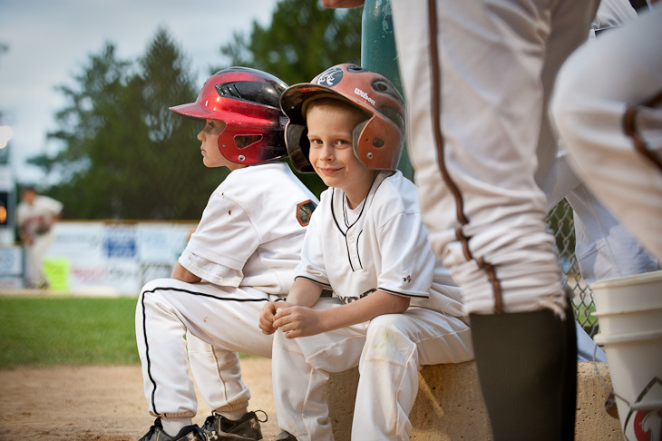
This is Matt. He likes to play baseball.
Notes:
TD: Ask student about sports they like to play. Do they like the same sport as Matt?

Slide 16
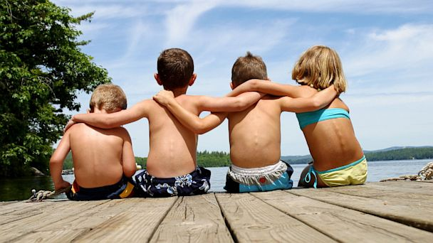
These friends like to swim.
Introduce yourself to them.
Notes:
TD: Have student introduce themselves to this group of friends. S should say name, age, things they like to do, etc.

Slide 17
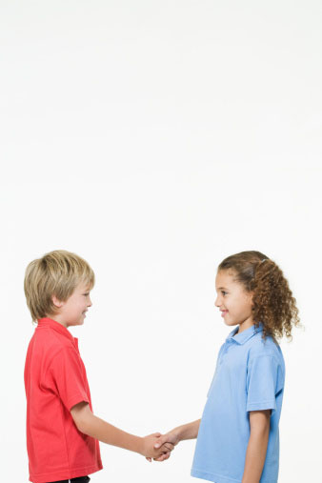
??
??
This is Jack and Ann. What are they saying?
Notes:
TD: Have S imagine what conversation these two might be having. T can act as one and S can act as the other and mimic conversation between the two.

Slide 18

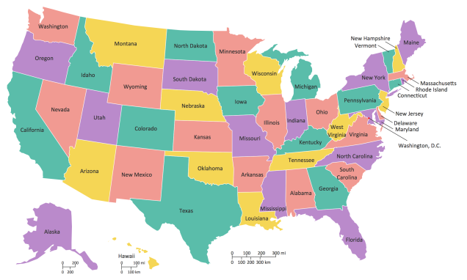

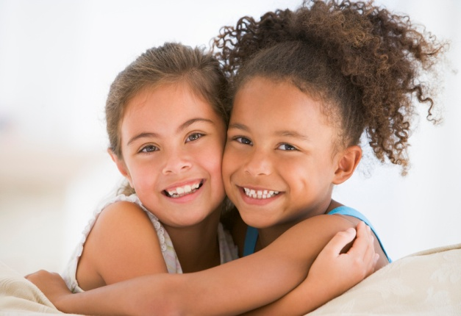

smile
USA
introduce
friend
meet
question
answer
Notes:
TD: Review the words about making friends. Use the words in complete sentences to make a conversation.

Slide 19

Your teacher is a new friend.
Introduce yourself!
Notes:
TD: Have S try introducing themselves to you. Have them try to use as much vocabulary from the previous slide as possible.

Slide 20
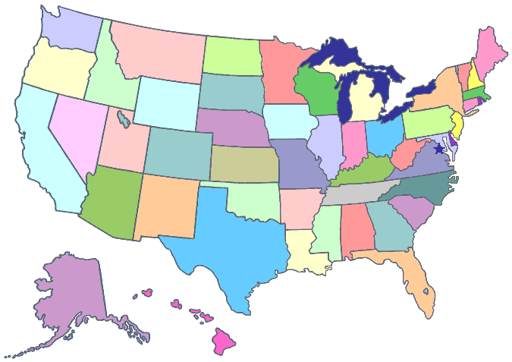
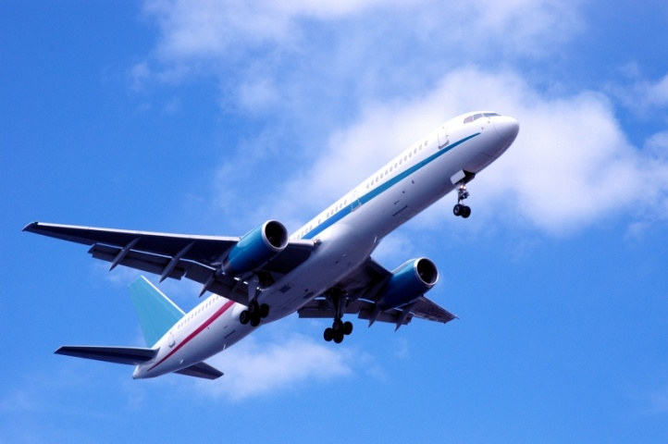

Thanks for visiting the United States, see you again soon!

Slide 21
Goodbye!
See you next time.
Goodbye!
See you next time.
Goodbye, bye, bye.
Goodbye, bye, bye.

Slide 22
Notes:
Sing goodbye song

